Slide 1

Introduction to R
Noah Lehman
Analyst
Criminal Justice Services
September 6th, 2018
Notes:
Install Tidyverse

Slide 2
Me
Degree in Public Policy from Berkeley with an emphasis on quantitative methodology.
Taught statistics and concepts in computing with data as a grad student.
Caveat: First time teaching here.
I like questions!
Notes:
For the last bullet emphasize my concern with appropriately tailoring this course to the needs of the judicial council.

Slide 3
Course Purpose
INTRODUCE topics in data science
Programming with data and statistics
Provide a foundation for practical work with data at JCC and a basis for further learning.
Expertise takes time.

Slide 4
Course Overview
CAVEAT 2: Everything I say is generalized.
Schedule
Class 1: Intro to Data and R.
Class 2: Intro to Statistics/Probability.
Class 3: Statistics/Probability Cont..

Slide 5
Class 1: Intro to data and R
What is data science?
The Structure of Data.
What and why R?
Introduction to R.

Slide 6
Class 2: Intro to Statistics/Probability
Measures of central tendency
Measures of variance
Density/mass distributions
Probability
Visualization with ggplot.

Slide 7
Class 3: Statistics/Probability Cont.
The normal distribution
Law of large numbers and central limit theorem
Correlation and Covariance
Linear Regression

Slide 8
What is Data Science and Why?
Data science is a "concept to unify statistics, data analysis, machine learning and their related methods" in order to "understand and analyze actual phenomena" with data.
-Hayashi, Chikio (1998-01-01)

Slide 9
Overview
Data vs “Big Data”
Why we want data for quantitative research
Describe, Predict, and Causally Infer
Answer the question, “Does it work?”
Barriers and Inevitability
Notes:
Whether it’s words on a page or 01 in a computer, data is just information represented symbolically.
Big Data is a marketing term, but does meaningfully represent the profound increase in the amount, speed, and type of data over time.

Slide 10
What is data?
Information Stored Symbolically
“Big Data”
Volume, Velocity, Variety, Veracity
Notes:
Whether it’s words on a page or 01 in a computer, data is just information represented symbolically.
Big Data is a marketing term, but does meaningfully represent the profound increase in the amount, speed, and type of data over time.

Slide 11
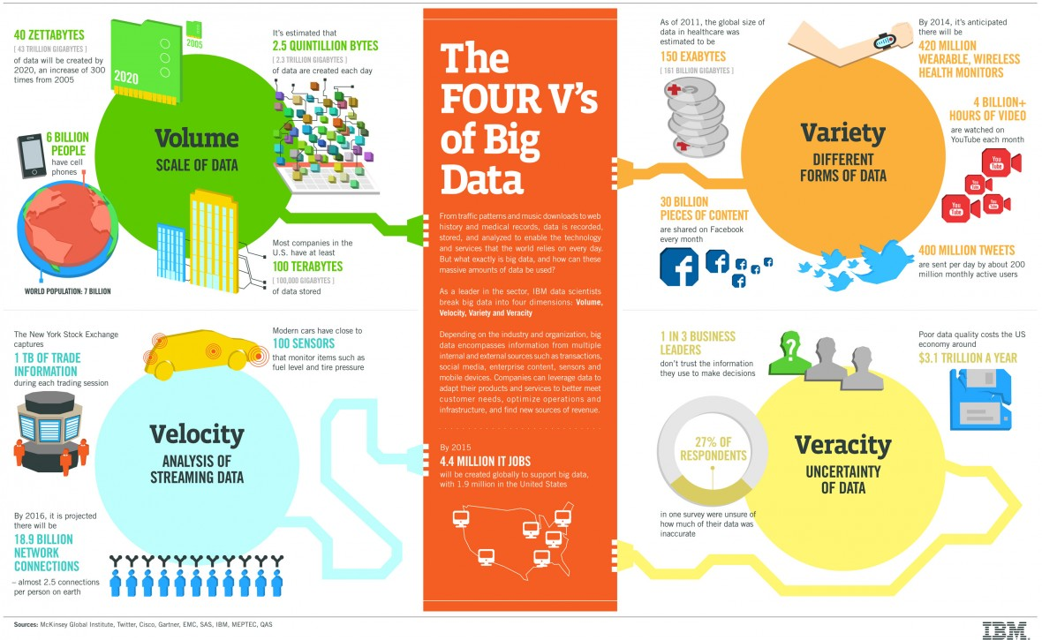

Slide 12
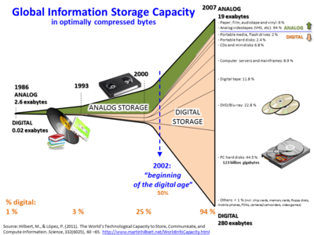
Why Now? Long Term Trends
Capacity
Speed
Price
Usability

Slide 13
Why do we want so much data?
Essential to understanding invaluable questions that have, historically, been impossible to answer with rigor.
Notes:
Abstractly: Helps us tell the truth about what is, what will be, and why.
Societally the dominant factor has been the profitability of data. I’ll talk about this more later, but the largest reason for this increase relates to investors and businesses ability to use data to make predictions about the future:
Eg. Which stock will go up, how much coffee to plant to meet demand, where should political adds be targeted?
Locally: press button
Make better informed decisions based on rigorous analysis.

Slide 14
Data Science is OSEMN
Obtain
Scrub
Explore
Model
iNterpret
-Data Science at the Command Line
Jeroen Janssens

Slide 15
Obtain
Download data from another location (e.g., a web page or server)
Query data from a database or API (e.g., MySQL or Twitter)
Extract data from another file (e.g., an HTML file or spreadsheet)
Generate data yourself (e.g., reading sensors or taking surveys)

Slide 16
Scrub
Filtering lines
Extracting certain columns
Replacing values
Extracting words
Handling missing values
Converting data from one format to another

Slide 17
Explore
Look at your data
Derive statistics from your data
Create interesting visualizations

Slide 18
Model
Statistically
Describe
Predict
And Causally Infer

Slide 19
iNterpret
Drawing conclusions from your data
Evaluating what your results mean
Communicating your result

Slide 20
Why R Over Excel
More powerful data manipulation capabilities
It reads any type of data
Easier project organization
Reproducibility (important for detecting errors)
It's free
Advanced Statistics capabilities
State-of-the-art graphics
http://blog.revolutionanalytics.com/2014/10/why-r-is-better-than-excel.html

Slide 21
Why R
https://shiny.rstudio.com/gallery/movie-explorer.html
Report in any format
Interact with any data source
Write in any language
Do anything a computer can do!

Slide 22
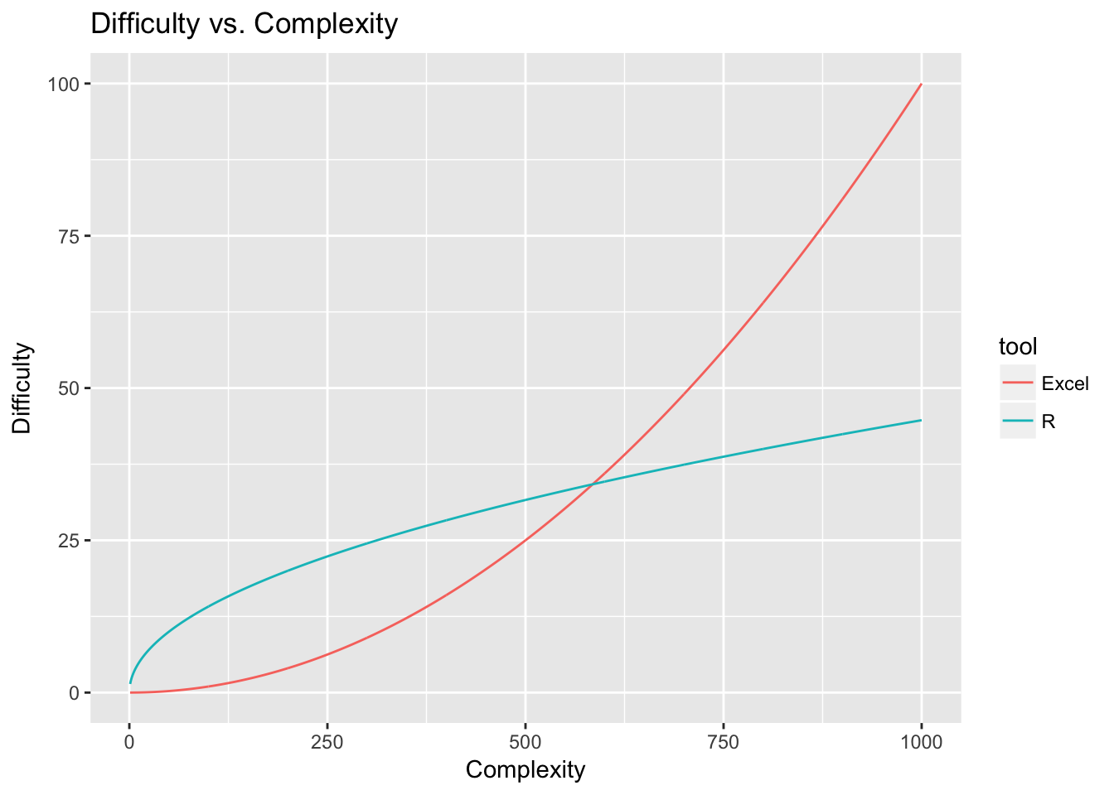
Why Not R?
Steep Learning Curve
Can be frustrating

Slide 23
Now Let’s Open R Studio!
https://github.com/xanzadu/Introduction-to-R

Slide 24
Explore the Environment
Tools -> Global Options -> Appearance
Packages
https://www.youtube.com/watch?v=ppn6DN99bd4

Slide 25
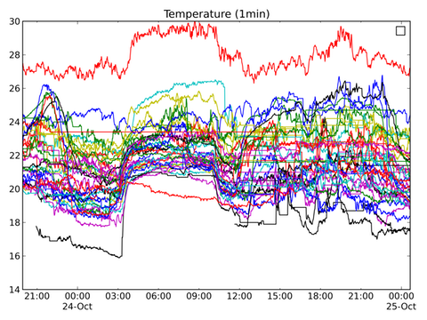
The Structure of Data

Slide 26
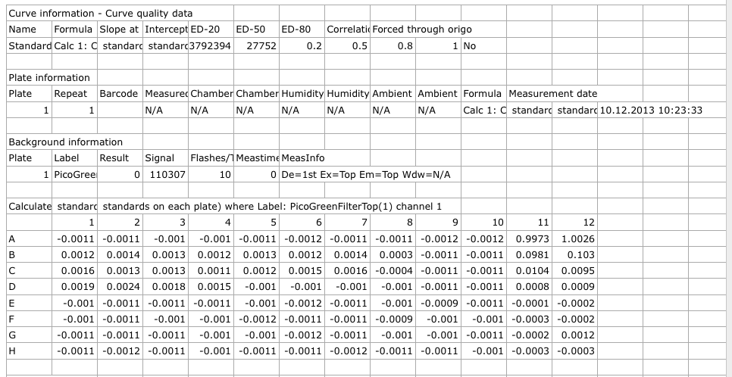
Messy Data

Slide 27
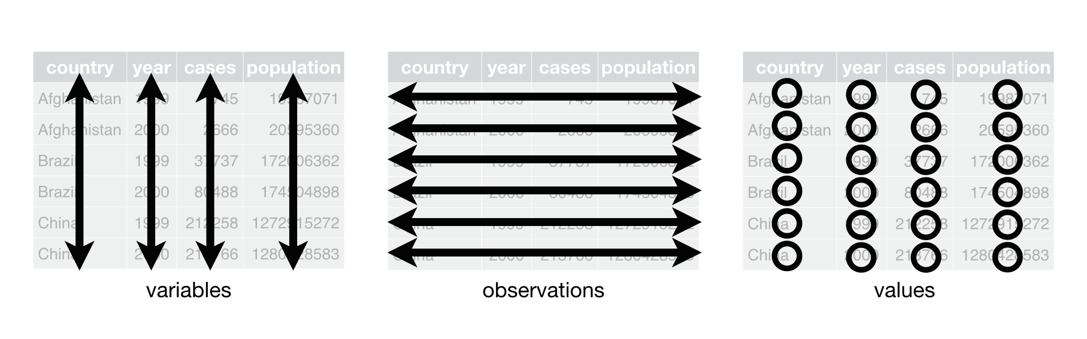
Tidy Data

Slide 28
Three Rules of Tidy Data
Each variable must have its own column.
Each observation must have its own row.
Each value must have its own cell.
Notes:
Abstractly: Helps us tell the truth about what is, what will be, and why.
Societally the dominant factor has been the profitability of data. I’ll talk about this more later, but the largest reason for this increase relates to investors and businesses ability to use data to make predictions about the future:
Eg. Which stock will go up, how much coffee to plant to meet demand, where should political adds be targeted?
Locally: press button
Make better informed decisions based on rigorous analysis.

Slide 29
Class 2: Introduction to Statistics
Variables
Shape of data – Descriptive Measures
Probability Distributions

Slide 30
Statistics
The science of collectiong, organizing, presenting, analyzing, and interpreting data to assist in making more effective decisions.

Slide 31
Variable
A variable is any characteristics, number, or quantity that can be measured or counted. A variable may also be called a data item.

Slide 32
Types of Variables
Variables
Qualitative
Quantitative
Dichotomic
Polynomic
Discrete
Continuous
Conviction status, Employment status
Charge level, Charge Code
Prior felonies, Prior FTAs
Sentence length, Age

Slide 33

Don’t Be Afraid of New Symbols!

Slide 34
The Shape of Data
Size
Central Tendency
Boundaries
Variability
Visual Shape

Slide 35
Size
i = index
x = variable
x_{i} = observation
n = number of observations
Σ = sum
Σ x_{i} = sum of observations

Slide 36

Central Tendency
mean = $\overline{x}$ = Σ x_{i} /n
median = middle value

Slide 37
Exercise
Find the number of observations, the value of the 5th observation, the mean, and the median of the following vector: (1,3,5,8,12)

Slide 38
Boundaries
Range: min, max, and max-min

Slide 39
Beware of outliers!
No standard definition.
It completely depends on your data.
Example:
Insurance cost
Housing values
Diamond Weight

Slide 40
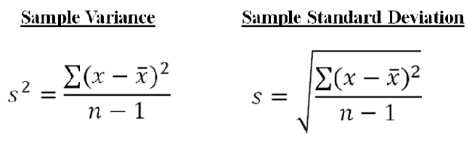
Variability

Slide 41
Why Variability?
R Excercise

Slide 42
Probability Distribution
Properties
Area = probability
Y-axis = density
X-axis = value
Full area always adds to 1

Slide 43
Probability Distribution
Continuous
Well described by a smooth density function.
Discrete
Well described by histograms

Slide 44
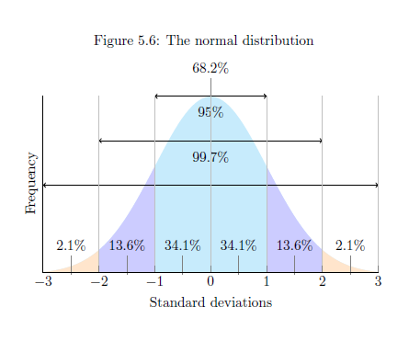
The Normal Distribution
Extraordinarily common distribution
Can be described with only mean and standard deviation.

Slide 45
Population vs Sample
Population = Entire group of interest
Sample = Observations on group of interest
Mental Shortcut – Population is theoretical, Sample is observed

Slide 46
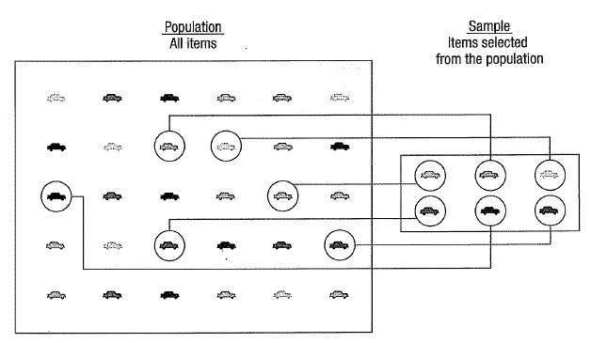

Slide 47
Distributions
Population – distribution of population observations
Sample – distribution of sample observations
Sampling – hypothetical distribution of sample means based on an infinite number of samples of a given sample size drawn from a population

Slide 48
Central Limit Theorem
As n increases…
The distribution of sample means tends toward the normal distribution…
Even if the original variable itself is not normally distributed.

Slide 49
Law of Large Numbers
As the number of experiments increases, the actual ratio of outcomes will converge on the theoretical, or expected, ratio of outcomes.

